Slide 1

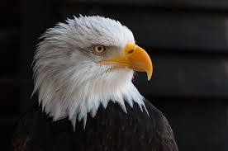


AGS LLC
ANALYTICAL GOVERNMENT SOLUTIONS
Defensible, highly accurate analytical products and decision analysis for Decision Makers
Introduction to C++
Day 1
13-17 December 2021
Pat Barton.
President/CEO, PES LLC
A Certified Service Minority
Owned Small Business
E. G. “Gil” Dickens, Jr.
President/CEO, AGS LLC
A Certified Service Disabled Veteran
Owned Small Business
(SDVOSB)
V 062419 egd

Slide 2
DAY 1
Today’s Objectives and Topics
Introduction to C++
IDE and command line operations
Your first C++ application
Namespace management
Standard library
Keywords
Operators
Console-based I/O streams
Basic variable/data types
Type-casting
Flow control with if / then / else
For statement and basic looping

Slide 3

Introduction to C++
Student and faculty introductions
Logistics
Questions?? YES!! Questions!
Platforms and tech
CodingRooms (self-contained)
BYOD
Slack
Schedule, breaks, lunch, etc.

Slide 4
Introduction to C++
Goals - in this class you will:
Write dozens of C++ programs
Learn basic language syntax
Learn the main variable types
Utilize collections
Code with logic loops and branches
Create functions and classes
Apply OOP concepts
Learn how to use pointers
Apply testing
Learn to manage exceptions
... and especially write dozens of C++ programs

Slide 5



Slide 6
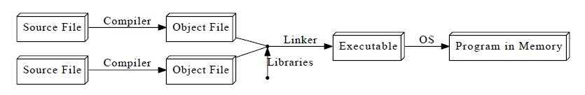
IDE and command line options (discussion)
# g++ is gnu’s c++ compiler
$ g++ -o hello.exe hello.cpp
$ ./hello
“Hello World”
$ g++ -save-temps -o hello.exe hello.cpp
$ ls
Mode LastWriteTime Length Name
---- ------------- ------ ----
-a---- 11/10/2021 1:32 PM 88 hello.cpp
-a---- 11/23/2021 1:26 PM 131063 hello.exe
-a---- 11/23/2021 1:26 PM 539060 hello.ii
-a---- 11/23/2021 1:26 PM 1839 hello.o
-a---- 11/23/2021 1:26 PM 2400 hello.s
$ g++ -o hello.exe hello.cpp
Notes:
Overview of what’s involved. Don’t need the details – just know they exist.

Slide 7
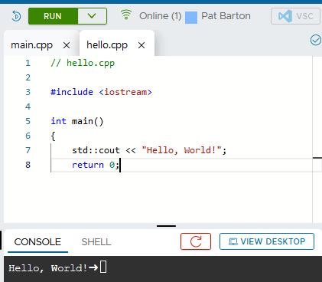
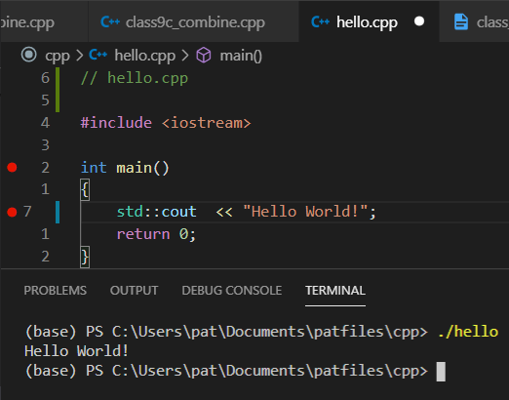
In your IDE you may see something like one of these:

Slide 8
Your first C++ application (demo)
// hello.cpp
#include <iostream>
int main()
{
std::cout << "Hello World!";
return 0;
}
Notes:
Hello1.anno

Slide 9
Console-based I/O text streams
std::cin
std::cout

Slide 10
Adding dialogue
// hello2_anno.cpp
#include <iostream> // IO opps
using namespace std; // full importation
int main() {
std::cout << "Hello World from hello2! You good?" << endl;
std::string resp = "Awesome"; // vars + types declared
std::cout << "I'm delighted that you're " + resp + "!";
return 0;
}
Notes:
Hello2_anno.cpp
Endl \n + flush buffer
Namespace references
Variable declaration
Double quotes for strings, single for char
String concat
Discuss escape characters, exp \”

Slide 11
Now you try ...
// file name here as a comment
// # include libraries here (no semicolons)
#include // name_of_included_library
// define your main entrypoint main like this
int main()
// the body of the main() function goes between curly braces
{
// declare any variables here
// find out favorite baseball team and store in variable
// write affirmative message e.g., GO Cubs !!
// return 0 for success
}
Notes:
Hello2_anno.cpp
Endl \n + flush buffer
Namespace references
Variable declaration
Double quotes for strings, single for char
String concat
Discuss escape characters, exp \”

Slide 12
Adding calculations
// hello4_ints.cpp
#include <iostream> // part of the standard library
#include <string> // also part of the standard library
int main()
{
std::string resp;
int age;
int days;
std::cout << "How are you ?" << std::endl;
//std::getline(std::cin >> std::ws, resp); // manipulator requires <string>
std::cin << resp;
std::cout << "I'm delighted that you're " + resp + "!\n";
std::cout << "How old are you? ";
std::cin >> age;
std::cout << "So you're " << age << " That's " << age * 365.25 << " days.\n";
days = age * 365.25;
std::cout << "Days is specified as an integer, remembered as: " << days;
return 0;
}
Notes:
Hello2_anno.cpp
Endl \n + flush buffer
Namespace references
Variable declaration
Double quotes for strings, single for char
String concat
Discuss escape characters, exp \”

Slide 13
Now you try ...
// file name here as a comment
// # include libraries here (no semicolons)
#include // library name(s), one per line
int main()
// the body of the main() function goes between curly braces
{
// declare any variables here
// ask size of largest fish user ever caught
// report back 75% of the user’s claim as text
// calculate 75% of the user’s claim in a variable
// report the variable’s value as text
// return 0 for success
}
Notes:
Hello2_anno.cpp
Endl \n + flush buffer
Namespace references
Variable declaration
Double quotes for strings, single for char
String concat
Discuss escape characters, exp \”

Slide 15
Standard library
General term for core tools
Namespace is “std”
Other libraries extend the language, but are not core
https://en.wikipedia.org/wiki/C++_Standard_Library
Incorporates C standard library w/ mangled names
<math.h> --> <cmath>
https://en.wikipedia.org/wiki/C_standard_library
We can access elements with statements like:
#include <iostream>
using std::cout;
Examples:
<array> | <iterator>
<deque> | <chrono>
<list> | <string>
<map> | <iostream>
<vector> | <valarray>

Slide 16
Keywords
Reserved – can’t use for anything else
Only around 50
auto | catch | for | private | template | sizeof | asm
double | throw | while | protected | class |  | new
const | try | return | public |  |  | delete
int |  | do | extern
long |  | else | virtual |  |  | inline
unsigned |  | break | friend
float |  | continue |  |  |  | this
enum |  | if
char |  | goto
short |  | case |  |  |  | typedef
signed |  | switch
void |  | default |  |  |  | volatile
static
struct |  |  |  |  |  | register
union

Slide 17
Some important operators
Math | Compare | Boolean | Bitwise
a + b | a == b | !a (not works) | ~a
a – b | a != b | a && b (and works) | a & b (bitand works)
+a | a > b | a || b (or works) | a | b (bitor works)
-a | a < b |  | a ^ b (xor works)
a * b | a >= b |  | a << b
a / b | a <= b |  | a >> b
a % b | a <=> b
++a
a++
--a
a--
Operator precedence
Complicated. 15 groups
Generally: scoping, (type assignment, postfix, function calls),(logical, prefix, pointers), (mult and div), (add and subtract)
https://docs.microsoft.com/en-us/cpp/cpp/cpp-built-in-operators-precedence-and-associativity?view=msvc-170

Slide 20
Basic variable/data types

Slide 21
Type-casting

Slide 22
for statement and basic looping

Slide 26
AGS LLC
ANALYTICAL GOVERNMENT SOLUTIONS
Defensible, highly accurate analytical products and decision analysis for Decision Makers
Introduction to C++
Day 2
13-17 December 2021
Pat Barton.
President/CEO, PES LLC
A Certified Service Minority
Owned Small Business
E. G. “Gil” Dickens, Jr.
President/CEO, AGS LLC
A Certified Service Disabled Veteran
Owned Small Business
(SDVOSB)
V 062419 egd

Slide 27
DAY 2
Today’s Objectives and Topics
Looping with while statements
File system I/O
Encapsulating code with functions
Encapsulating data with collections
Maps (dictionaries)
Lists and arrays
Introduction to templates
Vectors
Queues
Data structures

Slide 28

Looping with while statements

Slide 29
File system I/O

Slide 30
Encapsulating code with functions

Slide 31
Encapsulating data with collections

Slide 32
Maps (dictionaries)

Slide 33
Lists and Arrays

Slide 34
Introduction to Templates

Slide 35
Vectors

Slide 36
Queues

Slide 37
Data structures

Slide 38
AGS LLC
ANALYTICAL GOVERNMENT SOLUTIONS
Defensible, highly accurate analytical products and decision analysis for Decision Makers
Introduction to C++
Day 3
13-17 December 2021
Pat Barton.
President/CEO, PES LLC
A Certified Service Minority
Owned Small Business
E. G. “Gil” Dickens, Jr.
President/CEO, AGS LLC
A Certified Service Disabled Veteran
Owned Small Business
(SDVOSB)
V 062419 egd

Slide 39
DAY 3
Today’s Objectives and Topics
Introduction to pointers
Array management and navigation
Handling user input arrays
Flow control with switch statements
Functions types, return values, pointers
Function overloading
Clean code with functions

Slide 40

Introduction to pointers

Slide 41
Array management and navigation

Slide 42
Handling user input arrays

Slide 43
Flow control with switch statements

Slide 44
Functions types, return values, pointers

Slide 45
Function overloading

Slide 46
Clean code with functions

Slide 47
Standard library

Slide 48
Standard library

Slide 49
Standard library

Slide 50
Standard library

Slide 51
AGS LLC
ANALYTICAL GOVERNMENT SOLUTIONS
Defensible, highly accurate analytical products and decision analysis for Decision Makers
Introduction to C++
Day 4
13-17 December 2021
Pat Barton.
President/CEO, PES LLC
A Certified Service Minority
Owned Small Business
E. G. “Gil” Dickens, Jr.
President/CEO, AGS LLC
A Certified Service Disabled Veteran
Owned Small Business
(SDVOSB)
V 062419 egd

Slide 52
DAY 4
Today’s Objectives and Topics
Introduction to classes
Functions -> class methods
Variables -> class members
Classes versus instances
Managing instance namespaces
Inheritance
Class constructor overloading

Slide 53

Introduction to classes

Slide 54
Functions -> Class methods

Slide 55
Variables -> class members

Slide 56
Classes versus instances

Slide 57
Managing instance namespaces

Slide 58
Inheritance

Slide 59
Class constructor overloading

Slide 60
Standard

Slide 61
AGS LLC
ANALYTICAL GOVERNMENT SOLUTIONS
Defensible, highly accurate analytical products and decision analysis for Decision Makers
Introduction to C++
Day 5
13-17 December 2021
Pat Barton.
President/CEO, PES LLC
A Certified Service Minority
Owned Small Business
E. G. “Gil” Dickens, Jr.
President/CEO, AGS LLC
A Certified Service Disabled Veteran
Owned Small Business
(SDVOSB)
V 062419 egd

Slide 62
DAY 5
Today’s Objectives and Topics
Creating class libraries
Constructors and destructors
More on pointers
Arithmetic with pointers
Double pointers and arrays
“By reference” versus “By value” ops
Testing and test-driven development
Assertions

Slide 63

Creating class libraries

Slide 64
Constructors and destructors

Slide 65
More on pointers
Arithmatic

Slide 66
More on pointers
Double pointers and arrays

Slide 67
More on pointers
‘By reference” versus “by value” ops

Slide 68
Testing and test-driven development

Slide 69
Assertions

Slide 70
Standard

Slide 71
Standard

Slide 72
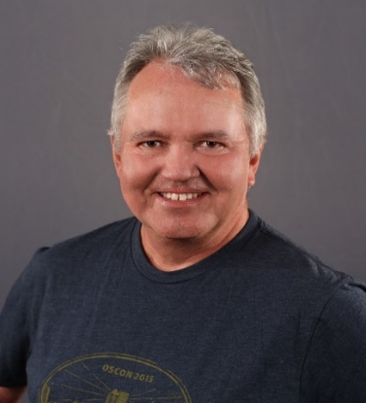
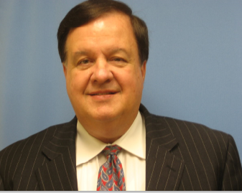
AGS LLC
ANALYTICAL GOVERNMENT SOLUTIONS
Defensible, highly accurate analytical products and decision analysis for Decision Makers
The AGS Staff and Instructors
Pat Barton and Gil Dickens
Wish to express our thanks to our Dahlgren SWC and Navy Community
For Joining Our Presentation of
AGS APPLIED PYTHON COURSE
July 19th – July 23rd 2021
Pat Barton.
President/CEO, PES LLC
A Certified Service Minority
Owned Small Business
E. G. “Gil” Dickens, Jr.
President/CEO, AGS LLC
A Certified Service Disabled Veteran
Owned Small Business
(SDVOSB)
V 072321 egd

